Slide 1


HIGH PERFORMANCE
BATCH PROCESSING

Slide 2


Slide 3

MICHAEL MINELLA
Lead – Spring Batch &
Spring Cloud Task
JSR-352 - Expert Group Member
Author – Pro Spring Batch
Speaker - JavaOne Rockstar
Podcast - OffHeap Curmudgeon
Twitter - @michaelminella or
@OffHeap

Slide 4


Slide 5

SLIDES AND CODE
WILL BE ON GITHUB SOON
https://github.com/mminella/scaling-demos

Slide 6

Notes:
Please ask questions when you have them

Slide 7


LAY OF THE LAND

Slide 8

SPRING FRAMEWORK

Slide 9

SPRING BATCH

Slide 10

SPRING CLOUD

Slide 11
SPRING CLOUD TASK

Slide 12

Notes:
Today we’re going to look at the most exciting area of IT

Slide 13

Notes:
Batch processing

Slide 14
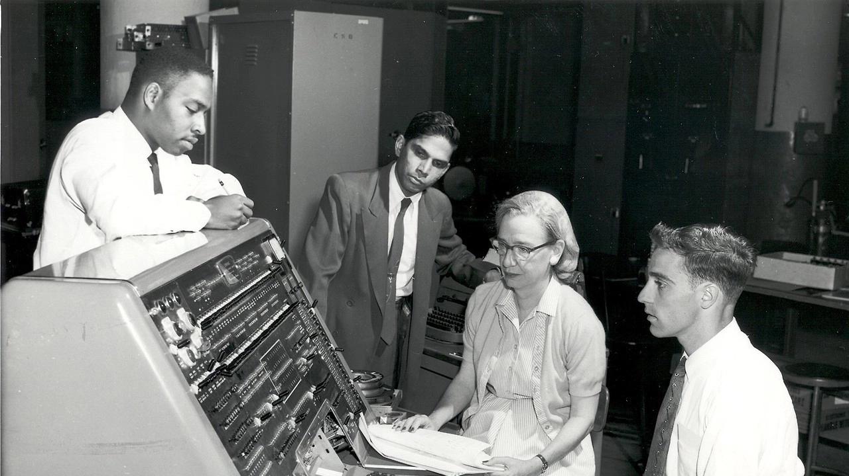
Notes:
While batch processing may be old

Slide 15

EFFECIENT USE OF
RESOURCES

Slide 16


SCALING SPRING BATCH
IS EASY

Slide 17
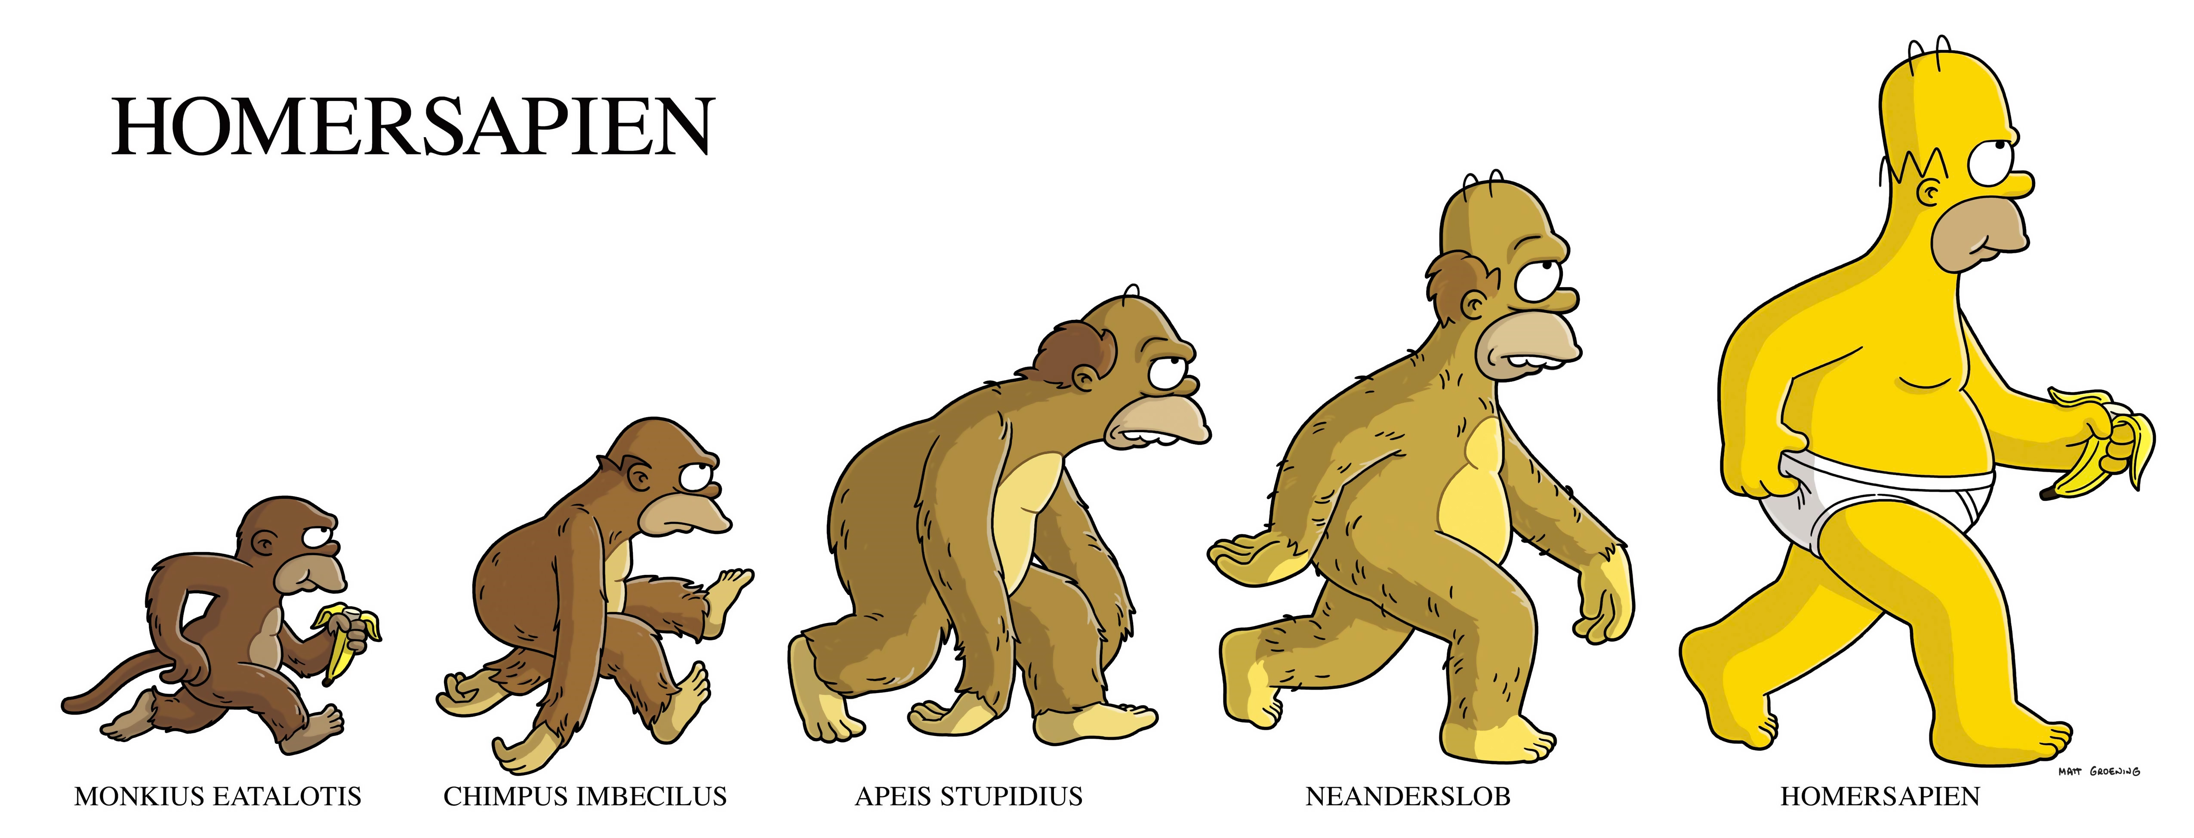
BATCH APPLICATIONS CAN
EVOLVE

Slide 18

METHODS OF SCALING
BATCH PROCESSES

Slide 19
1
PARALLEL STEPS

Slide 20
2
MULTITHREADED STEPS

Slide 21
3
ASYNC
ITEMPROCESSOR/ITEMWRITER

Slide 22
4
PARTITIONING

Slide 23
5
REMOTE CHUNKING

Slide 24




Transaction Files
Import Process

Slide 25
PARALLEL STEPS

Slide 26
ItemReader
ItemProcessor
ItemWriter
ItemReader
ItemReader
ItemProcessor
ItemProcessor
ItemWriter
ItemWriter

Slide 27
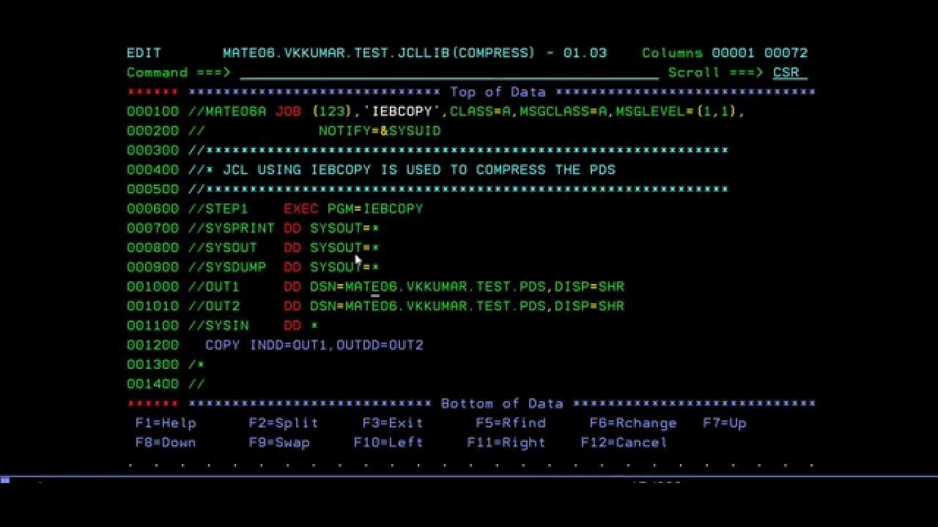
SHOW ME THE
CODE!

Slide 28

MULTITHREADED
STEPS

Slide 29
ItemReader
ItemReader
ItemProcessor
ItemReader
ItemProcessor
ItemReader
ItemWriter
ItemProcessor
ItemReader
ItemWriter
ItemProcessor
ItemReader
ItemWriter
ItemProcessor
ItemReader
ItemWriter
ItemProcessor
ItemReader
ItemWriter
ItemProcessor
ItemWriter
ItemProcessor
ItemWriter
ItemWriter

Slide 30
SHOW ME THE
CODE!

Slide 31

ASYNC ITEMPROCESSOR
& ITEMWRITER

Slide 32
ItemReader
ItemProcessor
ItemProcessor
ItemProcessor
ItemProcessor
ItemProcessor
ItemProcessor
ItemProcessor
ItemWriter

Slide 33
SHOW ME THE
CODE!

Slide 34

PARTITIONING

Slide 35
Partitioner
PartitionHandler
ItemReader
ItemReader
ItemReader
ItemProcessor
ItemProcessor
ItemProcessor
ItemWriter
ItemWriter
ItemWriter

Slide 36
SHOW ME THE
CODE!

Slide 37

REMOTE
CHUNKING

Slide 38
ItemReader
ItemWriter
ItemProcessor
ItemProcessor
ItemProcessor
ItemWriter
ItemWriter
ItemWriter

Slide 39
SHOW ME THE
CODE!

Slide 40
USING SPRING BATCH

Slide 41
YOU CAN EVOLVE YOUR
BATCH APPLICATIONS

Slide 42
TO DEVELOP
HIGH PERFORMANCE
BATCH APPLICATIONS

